Slide 1
Zeeman Effect
Depinder Singh
Assistant Professor in Physics
Govt. College, Ropar

Slide 2
The Zeeman Effect
Atoms in magnetic fields:
  Normal Zeeman effect
  Anomalous Zeeman effect

Slide 3
Zeeman Effect
First reported by Zeeman in 1896. Interpreted by Lorentz.
Interaction between atoms and field can be classified into two regimes:
  Weak fields: Zeeman effect, either normal or anomalous.
  Strong fields: Paschen-Back effect.
Normal Zeeman effect agrees with the classical theory of Lorentz. Anomalous effect depends on electron spin, and is purely quantum mechanical.

Slide 4
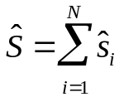
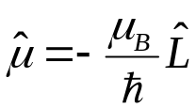
Norman Zeeman effect
Observed in atoms with no spin.
Total spin of an N-electron atom is
Filled shells have no net spin, so only consider valence electrons. Since electrons have spin 1/2, not possible to obtain S = 0 from atoms with odd number of valence electrons.
Even number of electrons can produce S = 0 state (e.g., for two valence electrons, S = 0 or 1).
All ground states of Group II (divalent atoms) have ns² configurations => always have S = 0 as two electrons align with their spins antiparallel.
Magnetic moment of an atom with no spin will be due entirely to orbital motion:

Slide 5

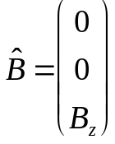

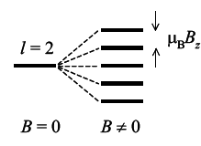
Norman Zeeman effect
Interaction energy between magnetic moment and a uniform magnetic field is:
Assume B is only in the z-direction:
The interaction energy of the atom is therefore,
where m_{l} is the orbital magnetic quantum number. This equation implies that B splits the degeneracy of the m_{l} states evenly.

Slide 6
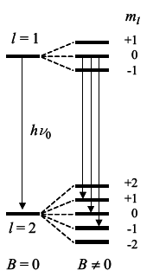
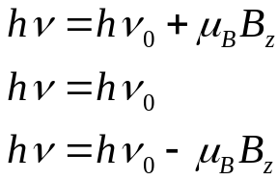
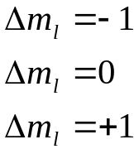
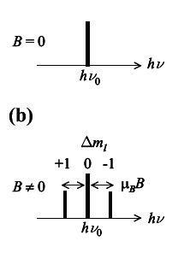
Norman Zeeman effect transitions
But what transitions occur? Must consider selections rules for m_{l}: Δm_{l} = 0, ±1.
Consider transitions between two Zeeman-split atomic levels. Allowed transition frequencies are therefore,
Emitted photons also have a polarization, depending
on which transition they result from.

Slide 7
Norman Zeeman effect transitions
Longitudinal Zeeman effect: Observing along magnetic field, photons must propagate in z-direction.
  Light waves are transverse, and so only x and y polarizations are possible.
  The z-component (Δm_{l} = 0) is therefore absent and only observe Δm_{l} = ± 1.
  Termed σ-components and are circularly polarized.
Transverse Zeeman effect: When observed at right angles to the field, all three lines are present.
  Δm_{l} = 0 are linearly polarized || to the field.
  Δm_{l} = ±1 transitions are linearly polarized at right angles to field.

Slide 8
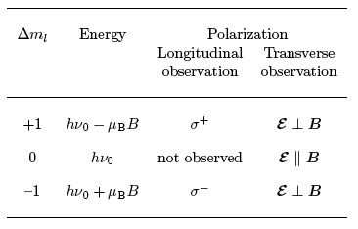
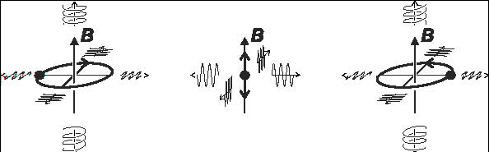
Norman Zeeman effect transitions
Last two columns of table below refer to the
polarizations observed in the longitudinal and
transverse directions.
The direction of circular polarization in the
longitudinal observations is defined relative to B.
Interpretation proposed by Lorentz (1896)
⁻
(Δm_{l}=-1 )
π
(Δm_{l}=0 )
⁺
(Δm_{l}=+1 )

Slide 9

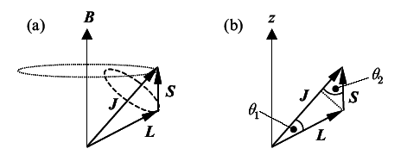
Anomalous Zeeman effect
Discovered by Thomas Preston in Dublin in 1897.
Occurs in atoms with non-zero spin => atoms with odd number of electrons.
In LS-coupling, the spin-orbit interaction couples the spin and orbital angular momenta to give a total angular momentum according to
In an applied B-field, J precesses about B at the Larmor
frequency.
L and S precess more rapidly about J to due to spin-orbit
interaction. Spin-orbit effect therefore stronger.

Slide 10
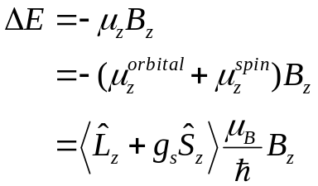



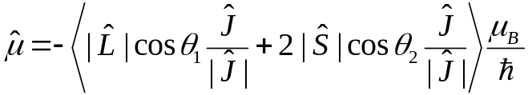
Anomalous Zeeman effect
Interaction energy of atom is equal to sum of interactions of spin and orbital magnetic moments with B-field:
where g_{s}= 2, and the < … > is the expectation value. The normal Zeeman effect is obtained by setting and
In the case of precessing atomic magnetic in figure on last slide, neither S_{z} nor L_{z} are constant. Only is well defined.
Must therefore project L and S onto J and project onto
z-axis =>

Slide 11
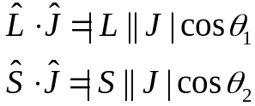
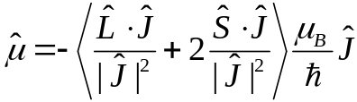


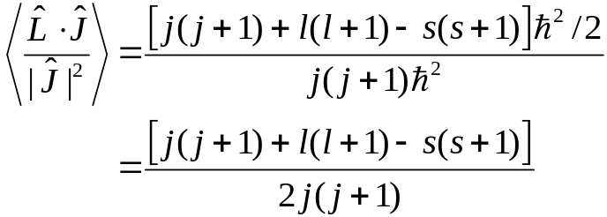
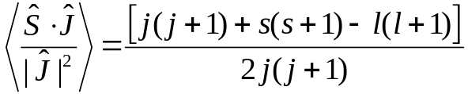

Anomalous Zeeman effect
The angles θ₁ and θ₂ can be calculated from the scalar products of the respective vectors:
which implies that (1)
Now, using implies that
therefore
so that
Similarly, and

Slide 12
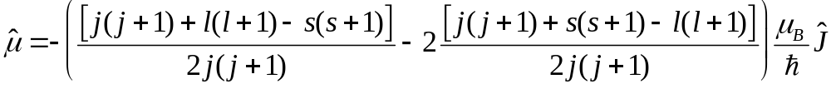

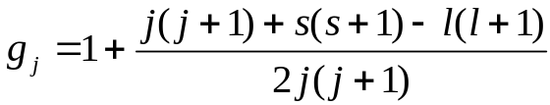


Anomalous Zeeman effect
We can therefore write Eqn. 1 as
This can be written in the form
where g_{J} is the Lande g-factor given by
This implies that
and hence the interaction energy with the B-field is
Classical theory predicts that g_{j} = 1. Departure from this due to spin in quantum picture.

Slide 13
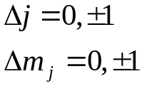
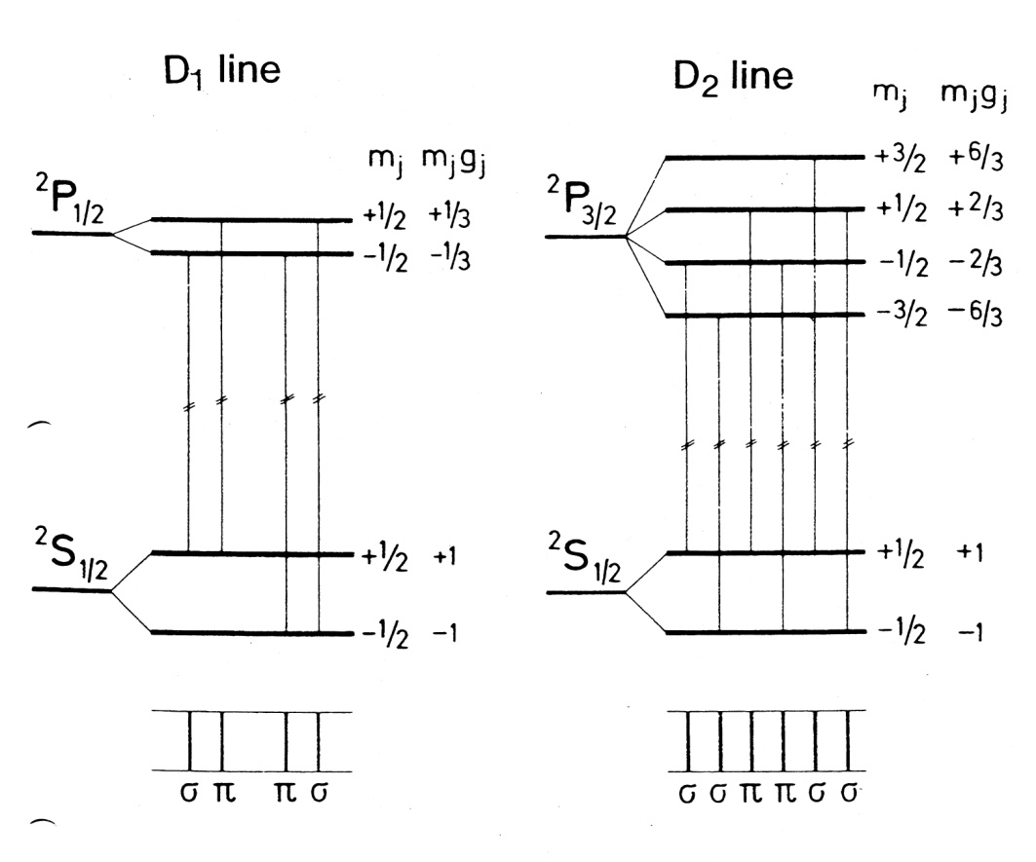
Anomalous Zeeman effect spectra
Spectra can be understood by applying the selection rules for J and m_{j}:
Polarizations of the transitions follow the
same patterns as for normal Zeeman effect.
For example, consider the Na D-lines
at right produced by 3p → 3s transition.

